Slide 1
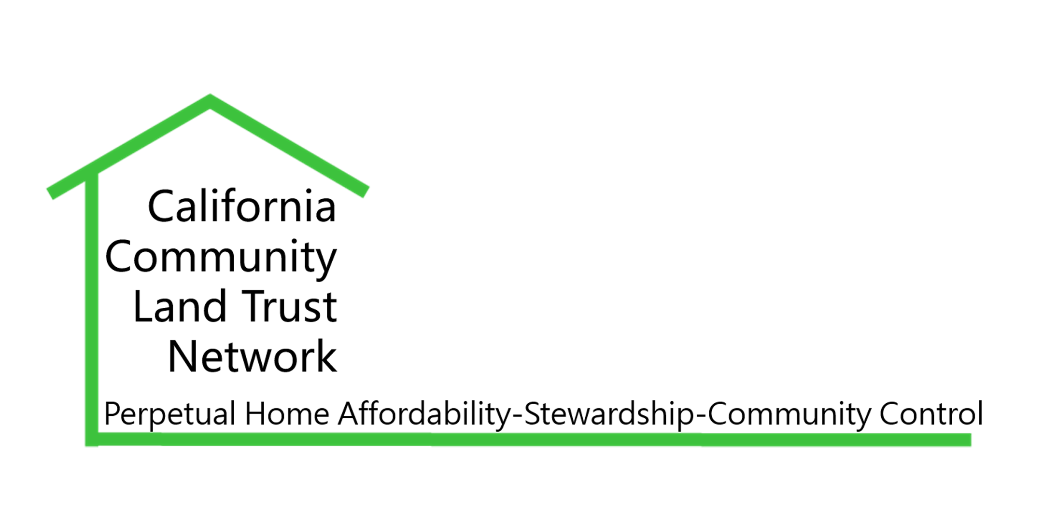
CACLTN Teach-In Series: Constituency Relationship Management (CRM) Systems for CLTs
Tuesday Oct 19, 12PM

Slide 2
Intro to CRM for Nonprofits
Bruce Wolfe, MSW
Boardmember, SFCLT
Treasurer, CARE CLT
CIO, Alcohol Justice

Slide 3
AGENDA
Overview and description of CRM systems.
A collection of contacts be it customers, clients, constituents, etc., and other relative data that various tools or applications can collectively use to achieve a certain objective or strategy.
Spreadsheet vs Database?
Data Entry: Webforms and website integration
Explanation of general tools used & how it works together with the database.
Types & suggested platforms
Demo of CiviCRM
Q&A

Slide 4
Conceptualize Need for CRM
Purpose, Goals & Use
Contacts
Fundraising
Membership
Events
Outreach
Volunteer/Intern Activity
Case Work
Analytics
Identify Tools To Achieve Goals (stay generic)
CRM-In-A-Can vs A La Carte
Subscription vs Free
Open-Source vs Proprietary
Developing Strategy & Futurethink
Singular, multiple and/or interacting purposes & use
Research Application Brands & Products

Slide 5
Questions & Answers
RESOURCES
https://www.capterra.com/nonprofit-crm-software/
CiviCRM
Action Network
Neon CRM
Salesforce
Zoho
Blackbaud
Monday

