Slide 1
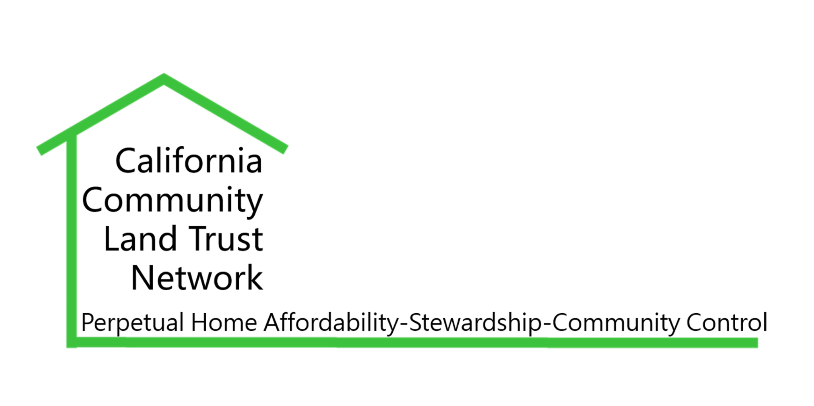
San Joaquin Valley Workshop Series
Start Up Stories and Funding Updates
This workshop series is possible thanks to the
SJV Funders’ Collaborative and Smart Growth CA
August 22, 2023
10:00 am- 12:00 pm
Zoom

Slide 2
Welcome & Introductions
Workshop Overview
Intro interpreters:
Lluvia Cardenas
Melody Gonzalez, Guani Tenoli Interpreting & Translations
Welcome
Workshop will be recorded & shared post meeting
Intro’s in the chat

Slide 3
Agenda
10:00 -10:10 Introductions
10:10 - 10:40 Speaker: Roberto Garcia-Ceballos
FCTL
10:40 - 10:50 Q & A
10:50 - 11:20 Speaker: David Cobb
Dishgamu Humboldt CLT
11:20 - 11:30 Q & A
11:30 - 11:45 Breakout Groups
11:45 - 11:55 New Opportunities
11:55 - 12:00 Closing

Slide 4
Background, Priorities & Objectives
SJV Funders supporting BIPOC-led community ownership
Past Workshop topics included:
-community ownership models, including CLT 101
-strengthening organizational structures,
-funding and government partnerships
Projects may include affordable housing, farms or other agricultural work, worker coops, nonprofit spaces, and multi-uses
Diverse communities in SJV, each with their unique needs
Connections to values-aligned funders & projects
Relationship-building for groups & organizations

Slide 5
Speakers’ Content
Land Back Effort, CLT Start-Up
Strategic Partnerships
Developing an Ecosystem for community ownership work

Slide 6
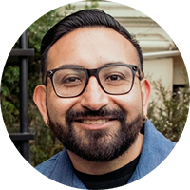
Intro Speaker
Roberto Garcia-Ceballos Co-Director (FCTL)
Notes:
Roberto Garcia-Ceballos is a community/cultural organizer and strategist based in Los Angeles (Tongva Land). He co-founded two community-based organizations (Fideicomiso Comunitario Tierra Libre and Community Power Collective) that collectively build collective land stewardship, community power building, and cultural vitality. He was born in Mexico City and raised in San Jose, CA. Fideicomiso Comunitario Tierra Libre (FCTL) was formed in 2019 when community members from Boyle Heights and East Los Angeles decided to fight gentrification by forming an organization that could take land and housing off the speculative market and put it into community control. Together we strive for the cultivation of space for the most vulnerable members in the neighborhood to be able to have a voice and live in what is being developed in their community.

Slide 7
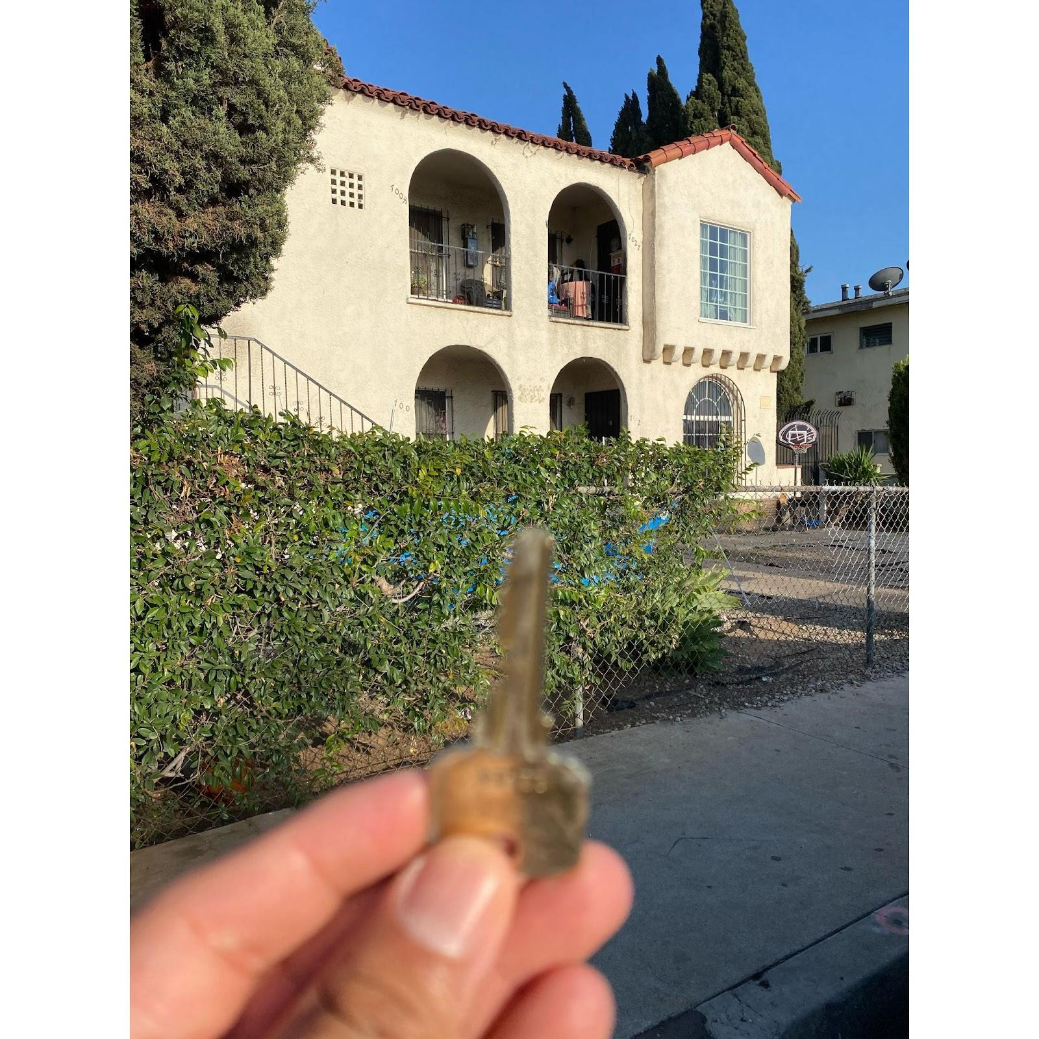
Fideicomiso Comunitario Tierra Libre (FCTL)
Roberto Garcia-Ceballos, Co-director, Fideicomiso Comunitario Tierra Libre (FCTL) /roberto@cpcollective.org
FCTL is member of:
The Los Angeles Community Land Trust Coalition (LA CLT Coalition)
California Community Land Trust Network

Slide 8
Fideicomiso Comunitario Tierra Libre (FCTL)
FCLT is a grassroots Community Land Trust (CLT) founded in 2018 with the support of community residents and community based organizations
Historically our communities have been disinvested and impacted by for profit development.
FCTL members sought to create an alternative to the housing crisis and displacement of our neighbors, friends and family members by securing community control and community ownership through the CLT model.
FCLT es un Fideicomiso de Tierras Comunitarias (CLT) de base fundado en 2018 con el apoyo de los residentes de la comunidad y las organizaciones comunitarias.
Históricamente, nuestras comunidades han sido desinvertidas e impactadas por el desarrollo con fines de lucro.
Los miembros de FCTL buscaron crear una alternativa a la crisis de vivienda y el desplazamiento de nuestros vecinos, amigos y familiares asegurando el control comunitario y la propiedad comunitaria a través del modelo CLT.
Notes:
Fanny

Slide 9
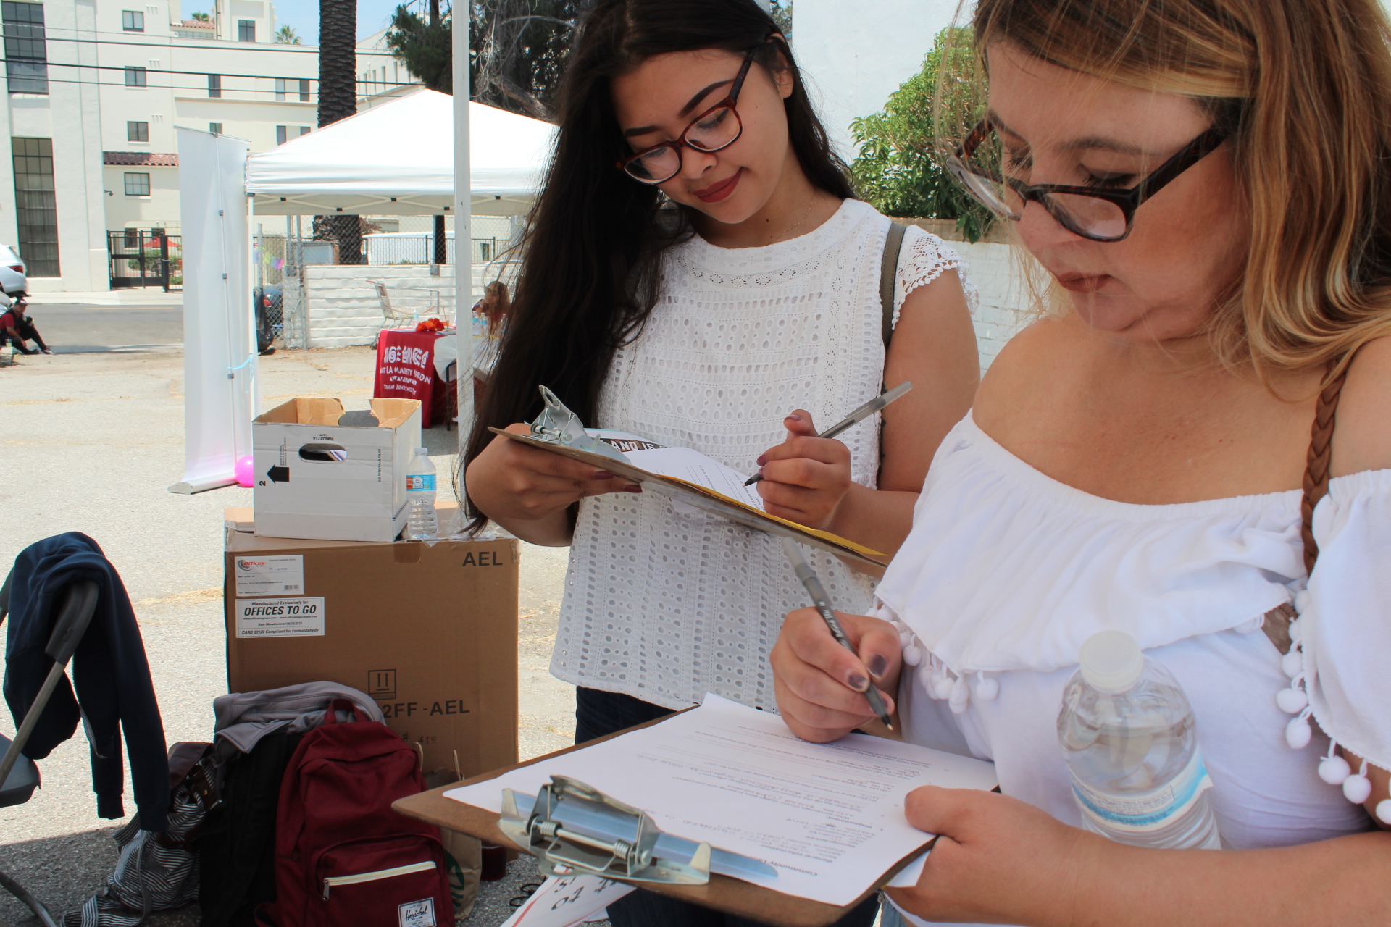
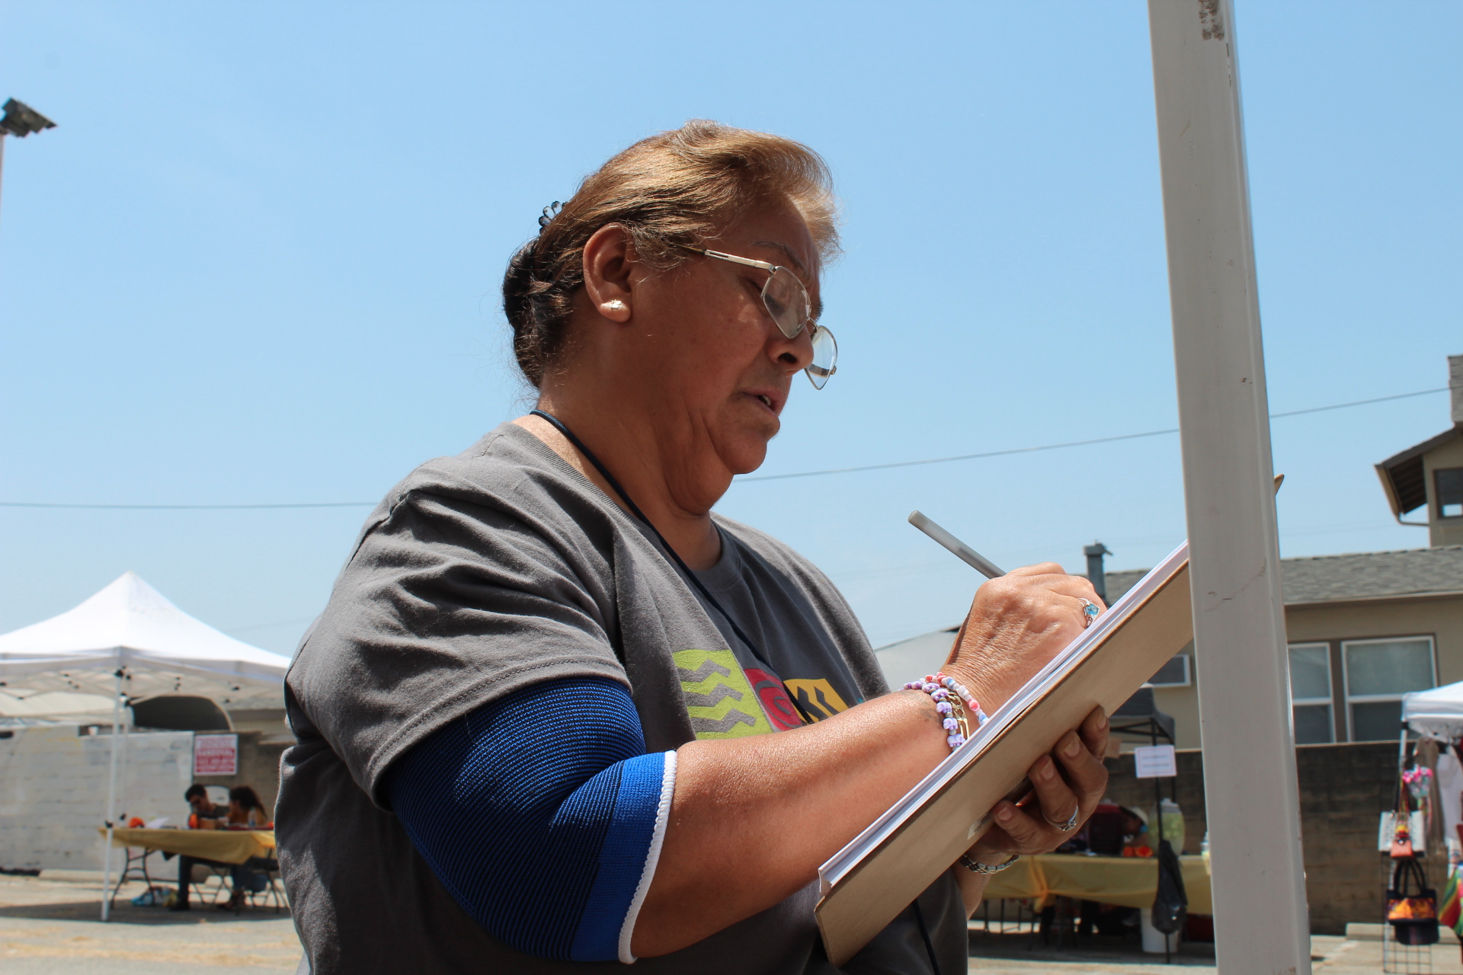
Educational Campaign In the Neighborhood
Campaña de Educación

Slide 10
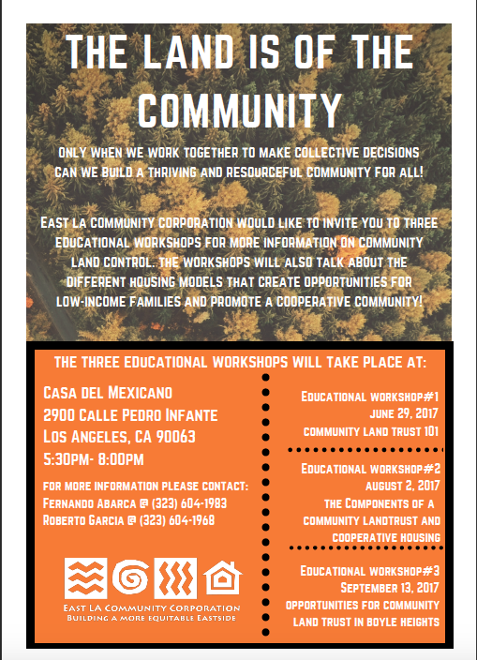
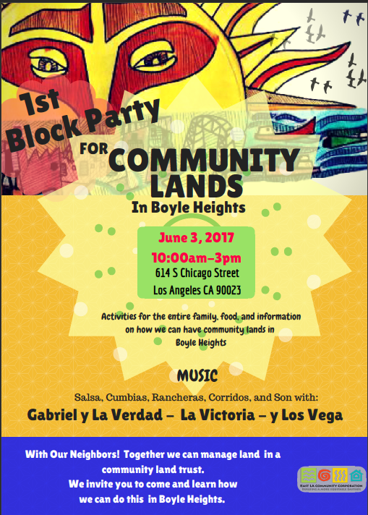

Slide 11
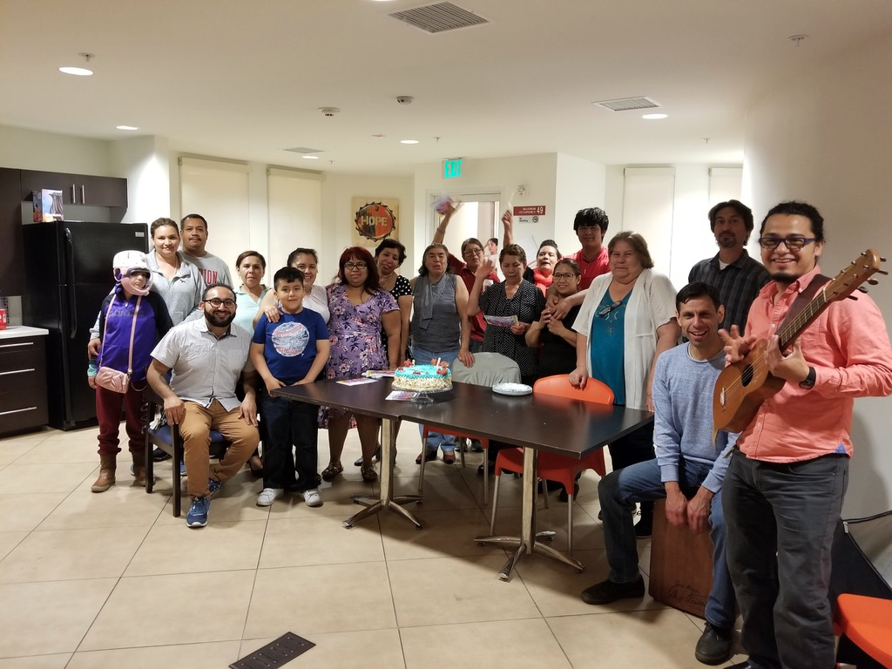
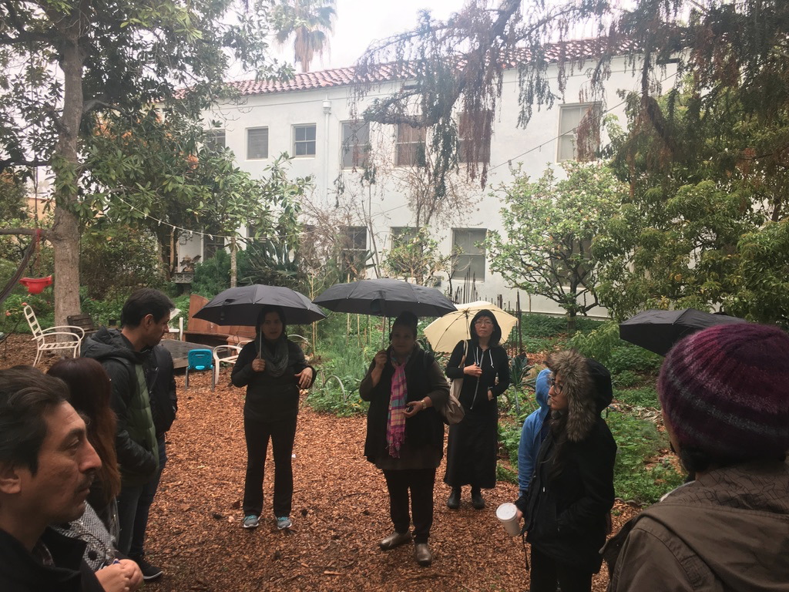
Fideicomiso Comunitario Tierra Libre se forma

Slide 12
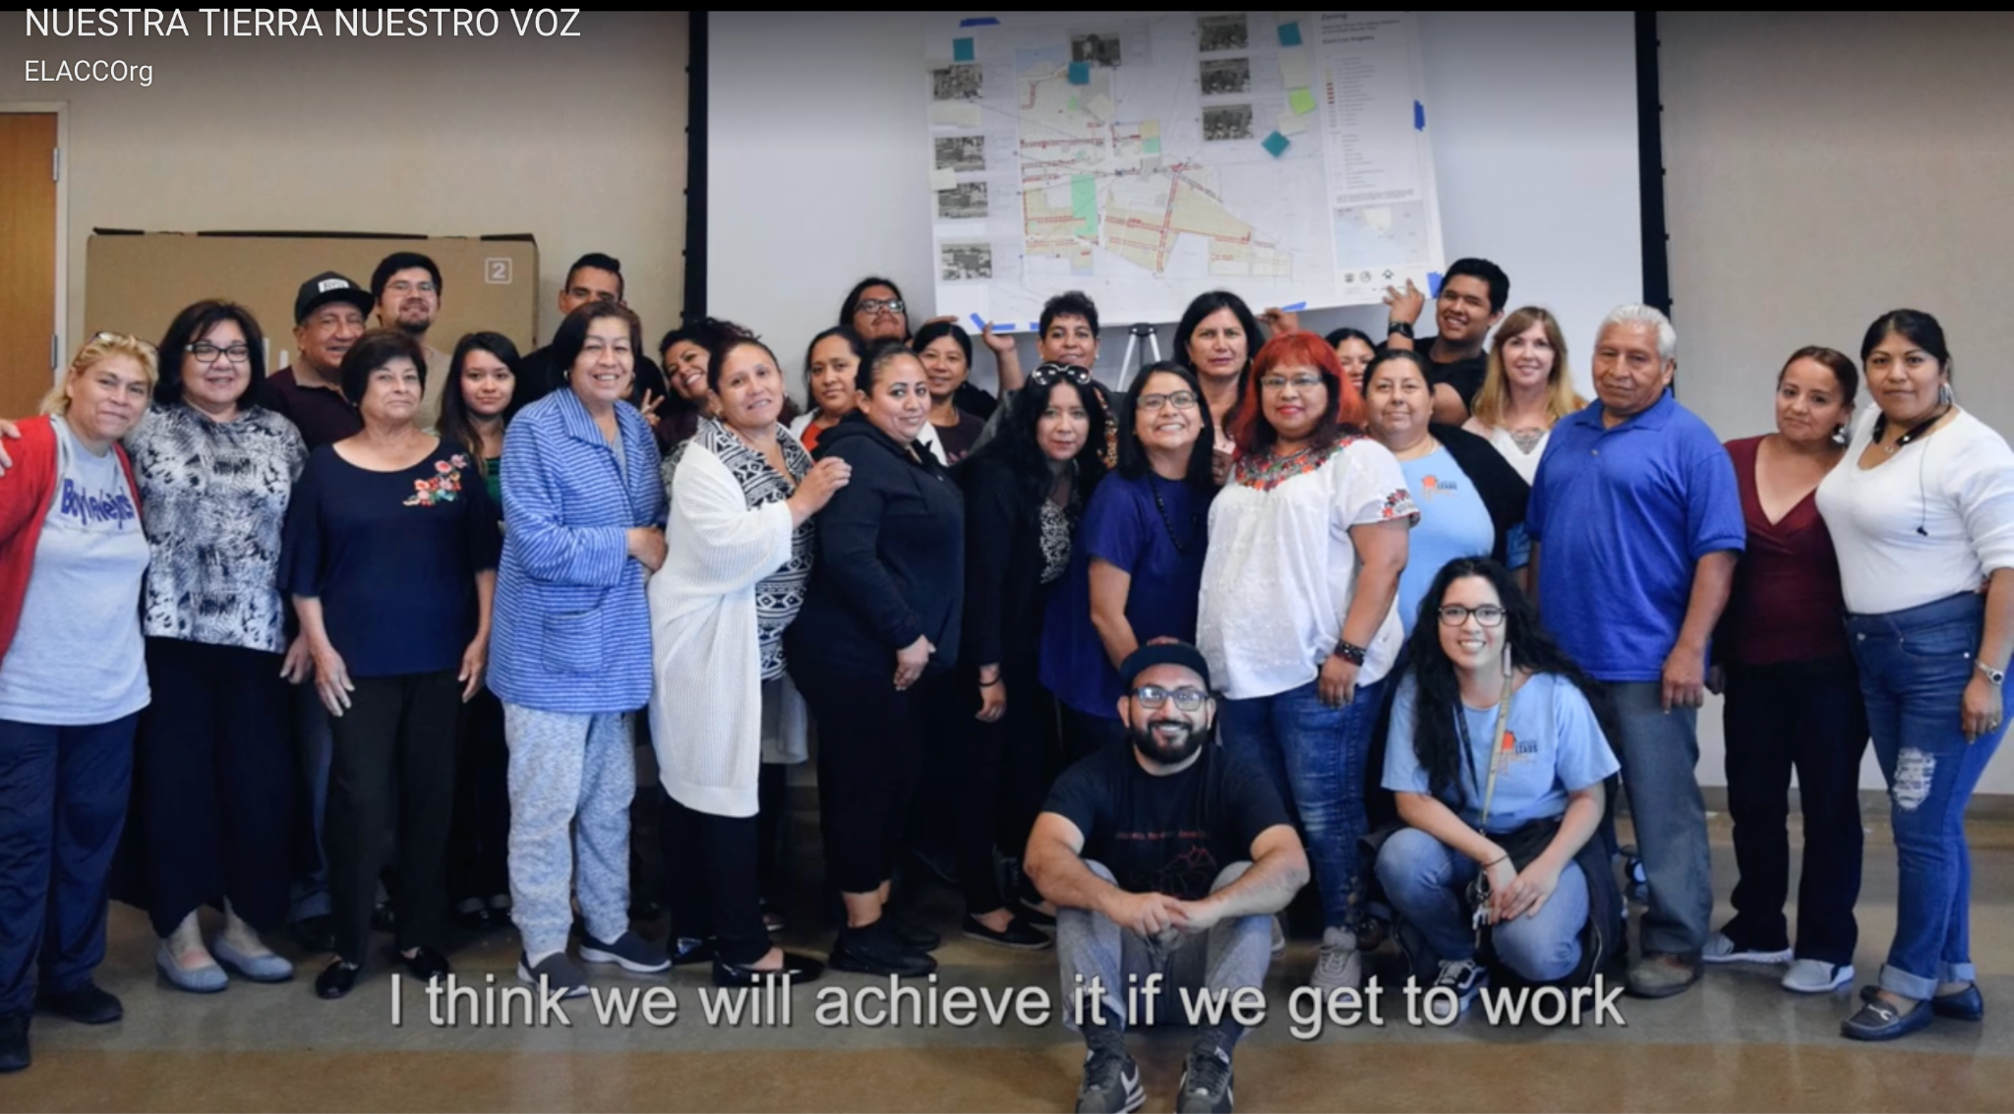
Video: NUESTRA TIERRA, NUESTRO FUTURO
Watch Video Here
Notes:
https://www.youtube.com/watch?v=Qp1bpmDO6bU

Slide 13
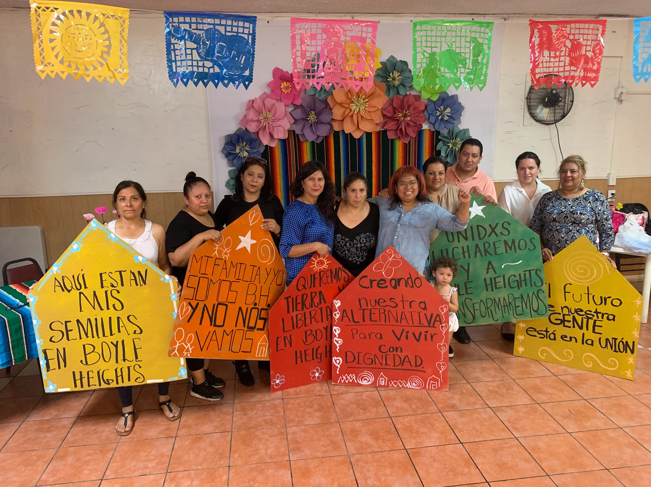

Slide 14
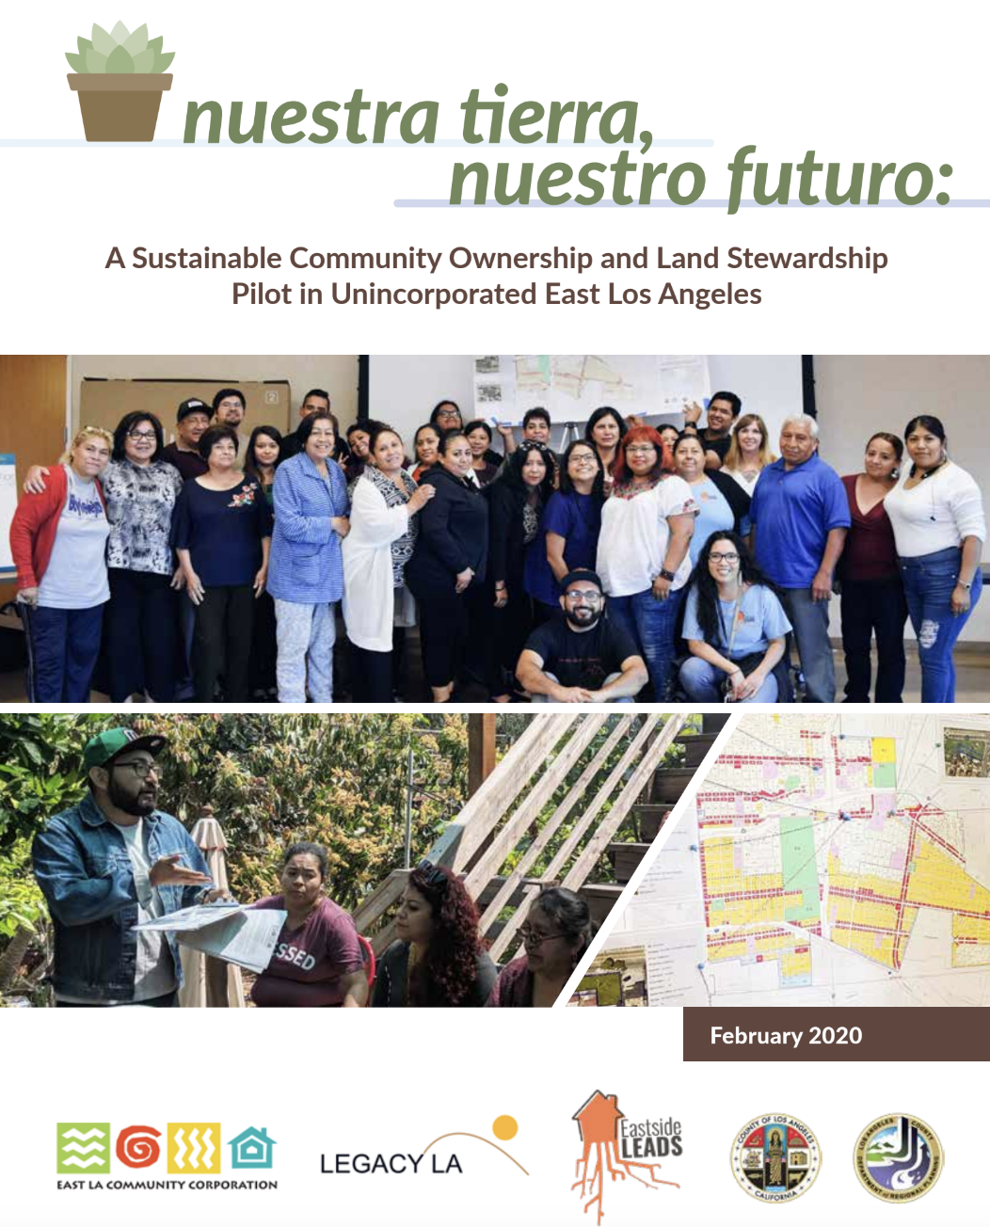
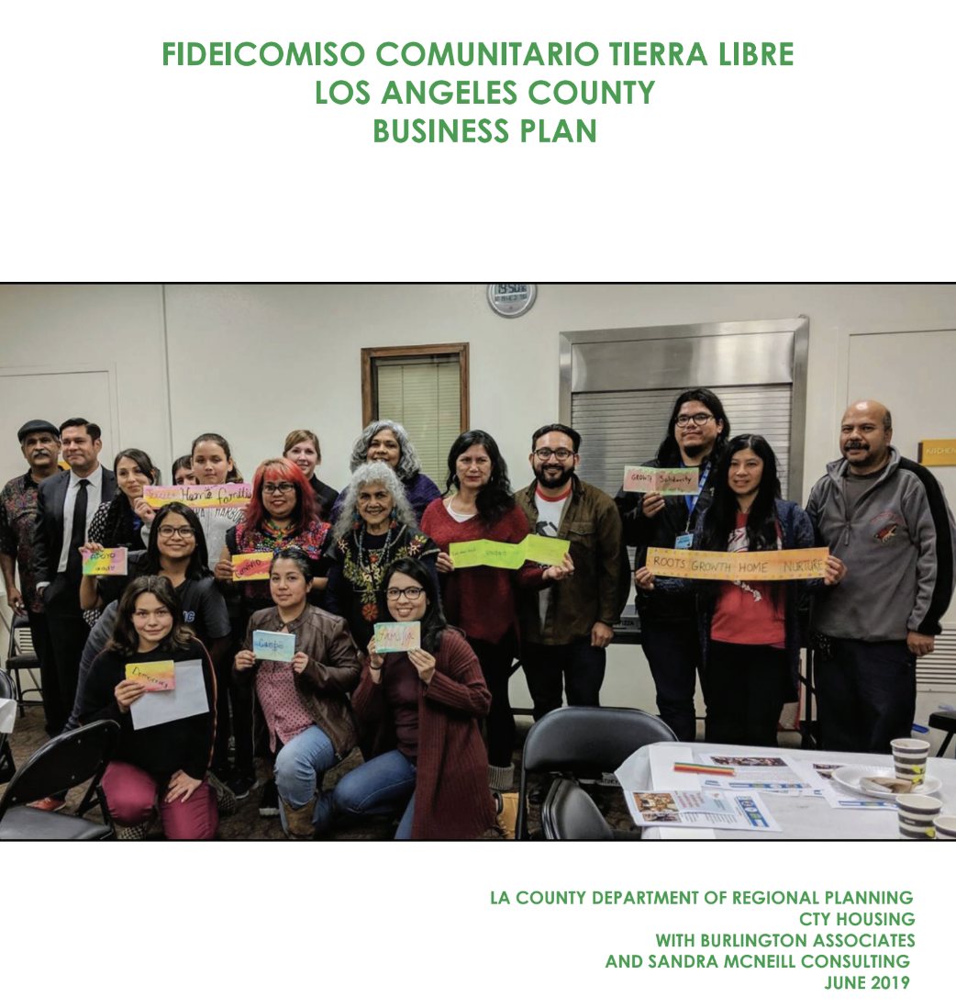
Notes:
Nuestra Tierra, Nuestro Futuro
FCTL LA Business Plan

Slide 15
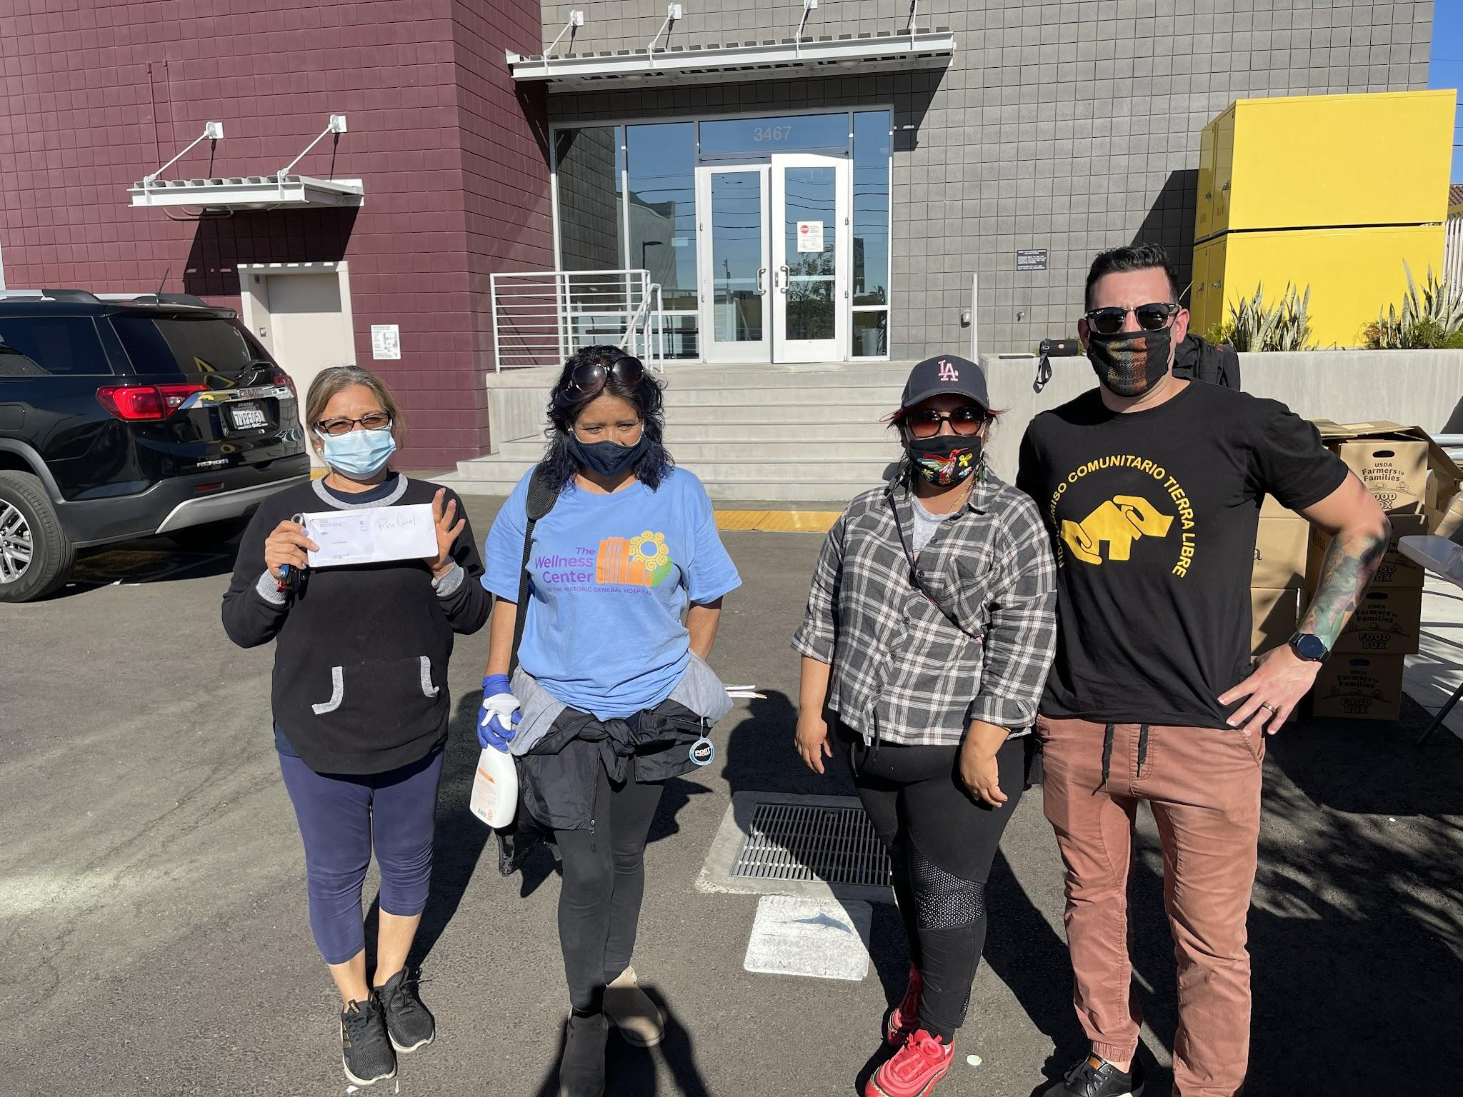
Nuestra lucha no paro apezar de la pandemia de COVID19/The adversity of COVID19 did not stop our work

Slide 16
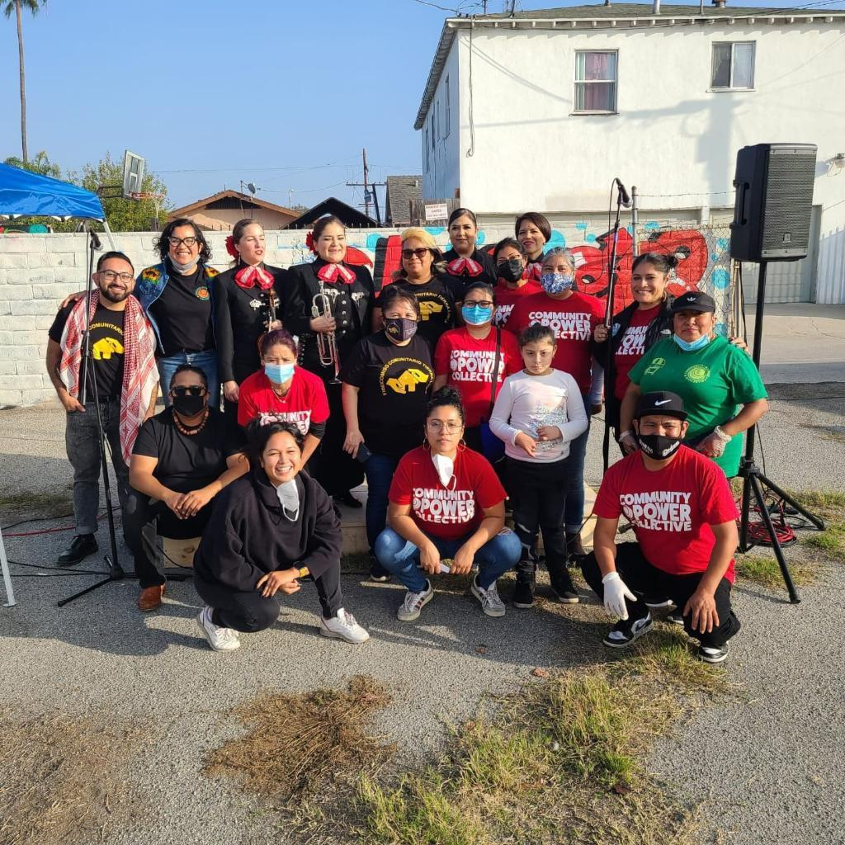
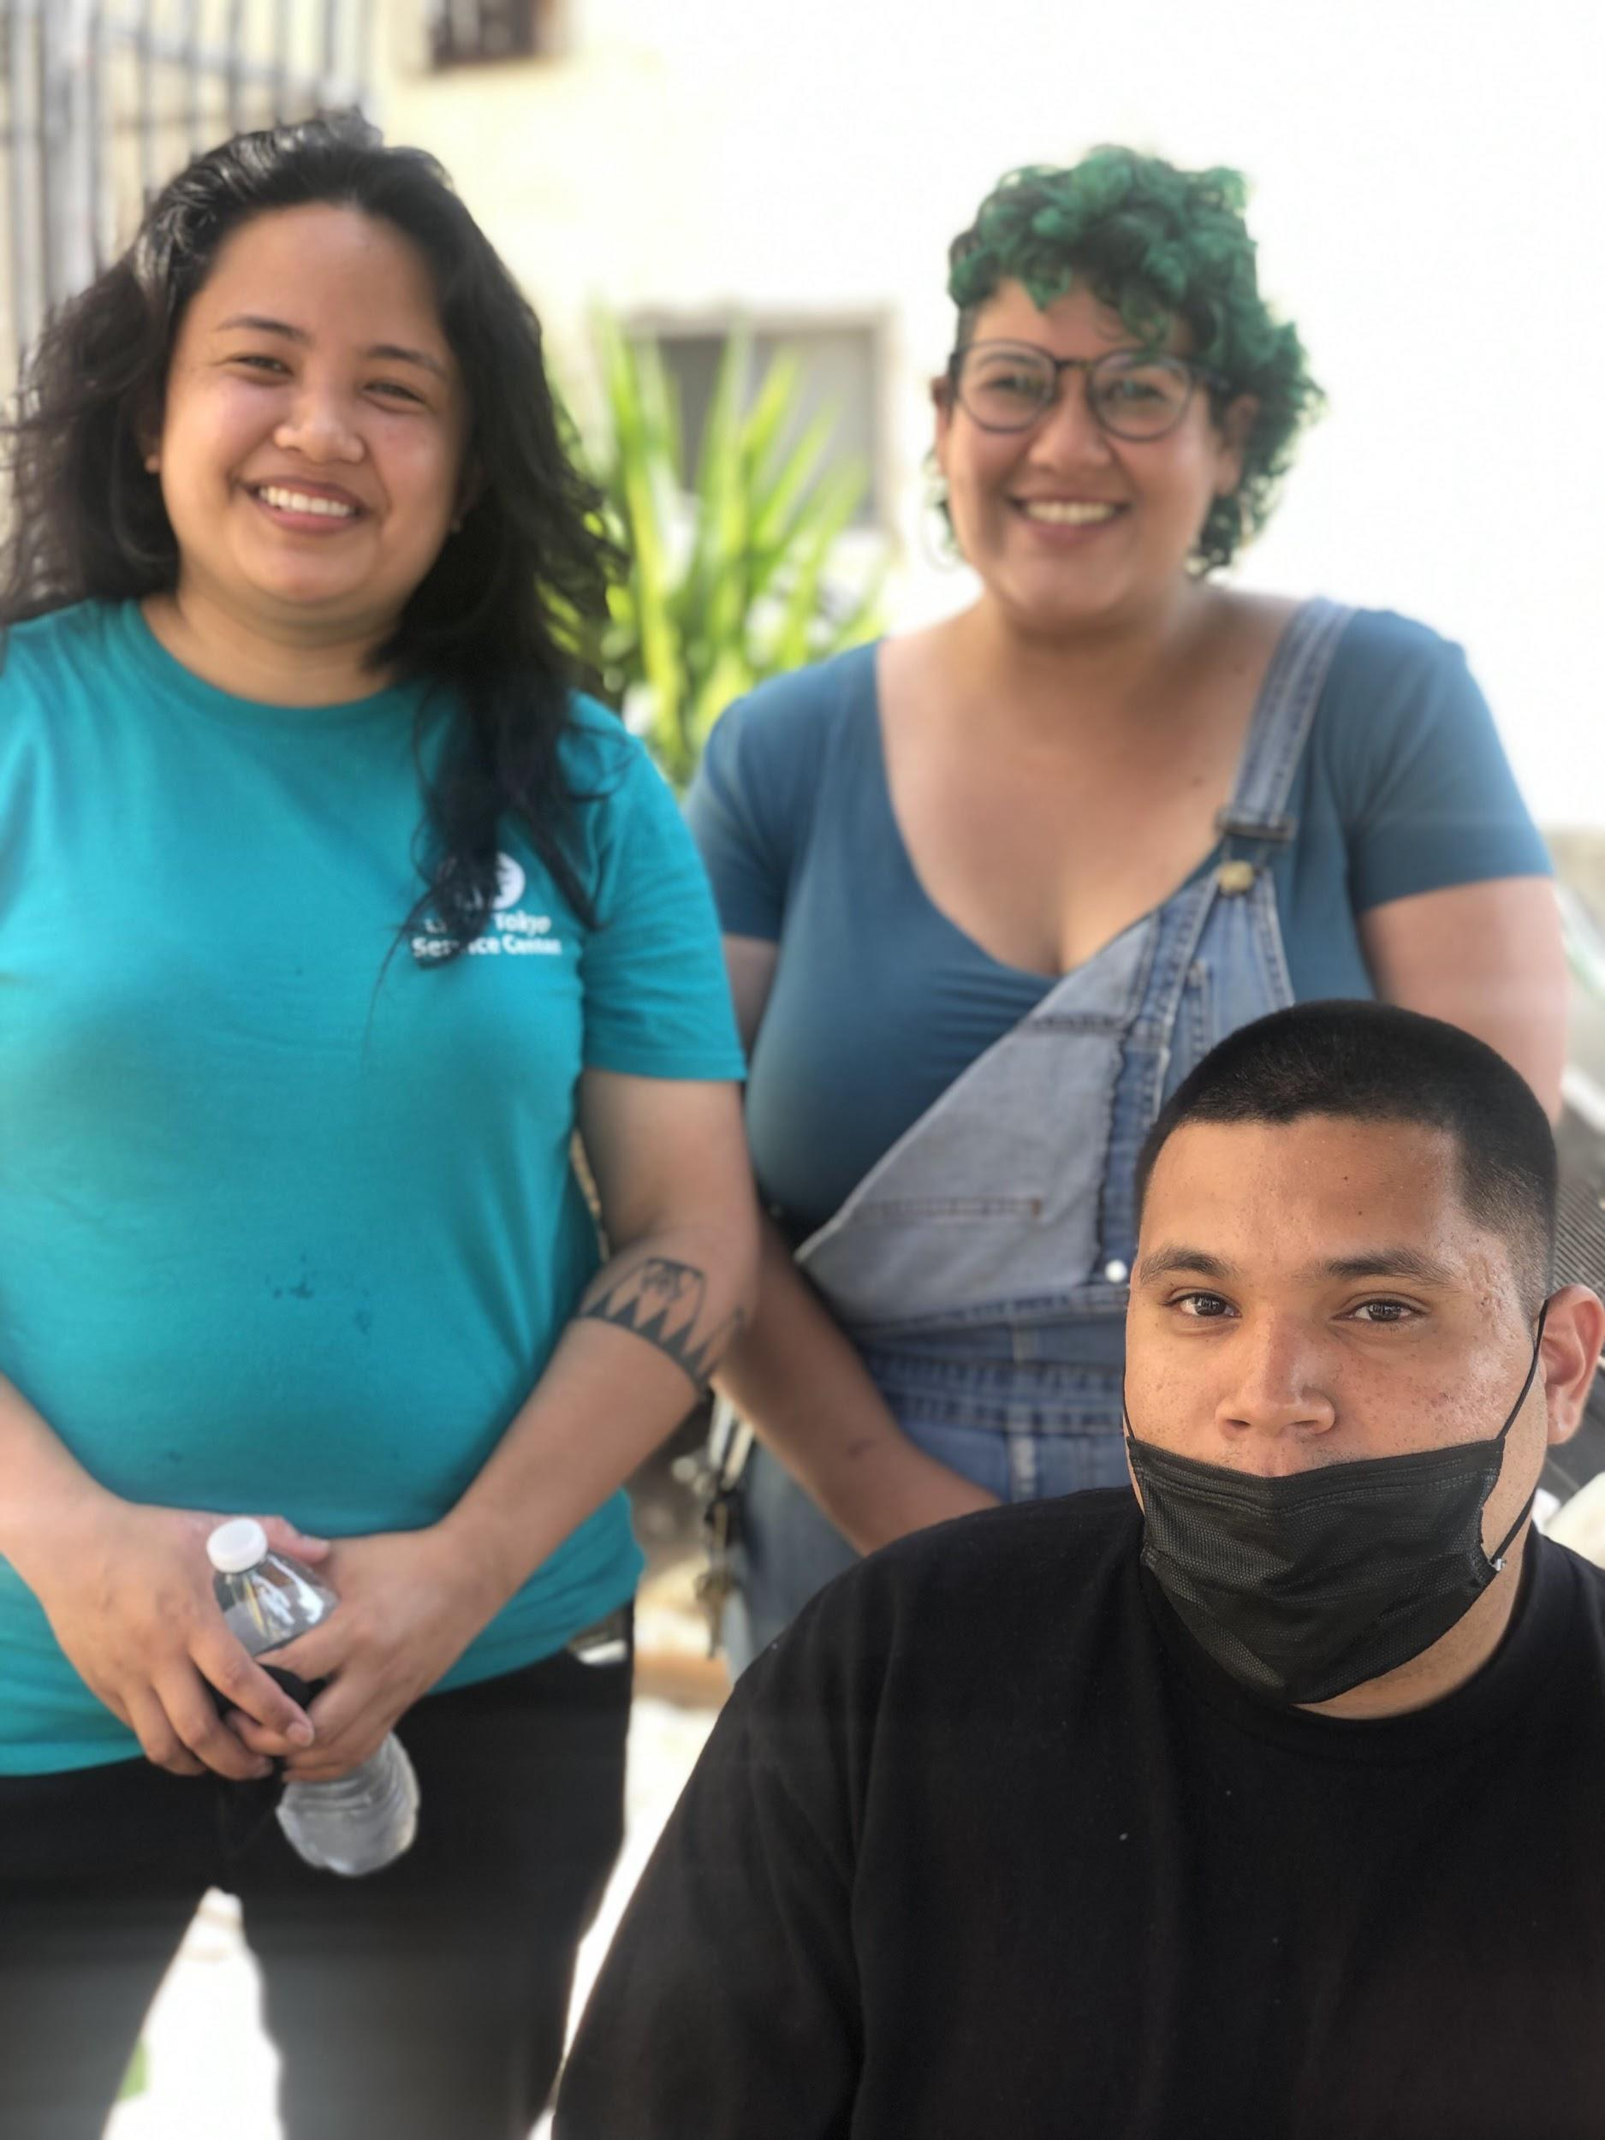
Strategic Partnerships - Socios Estrategicos
Community Land Trust Fideicomiso de Tierras Comunitarias | Community Based Organizations Organizaciones de base | Affordable Housing Developer Desarrollador de Vivienda
Fideicomiso Comunitario Tierra Libre | Community Power Collective | Little Tokyo Service Center Restore Neighborhoods Los Angeles, Inc.

Slide 17
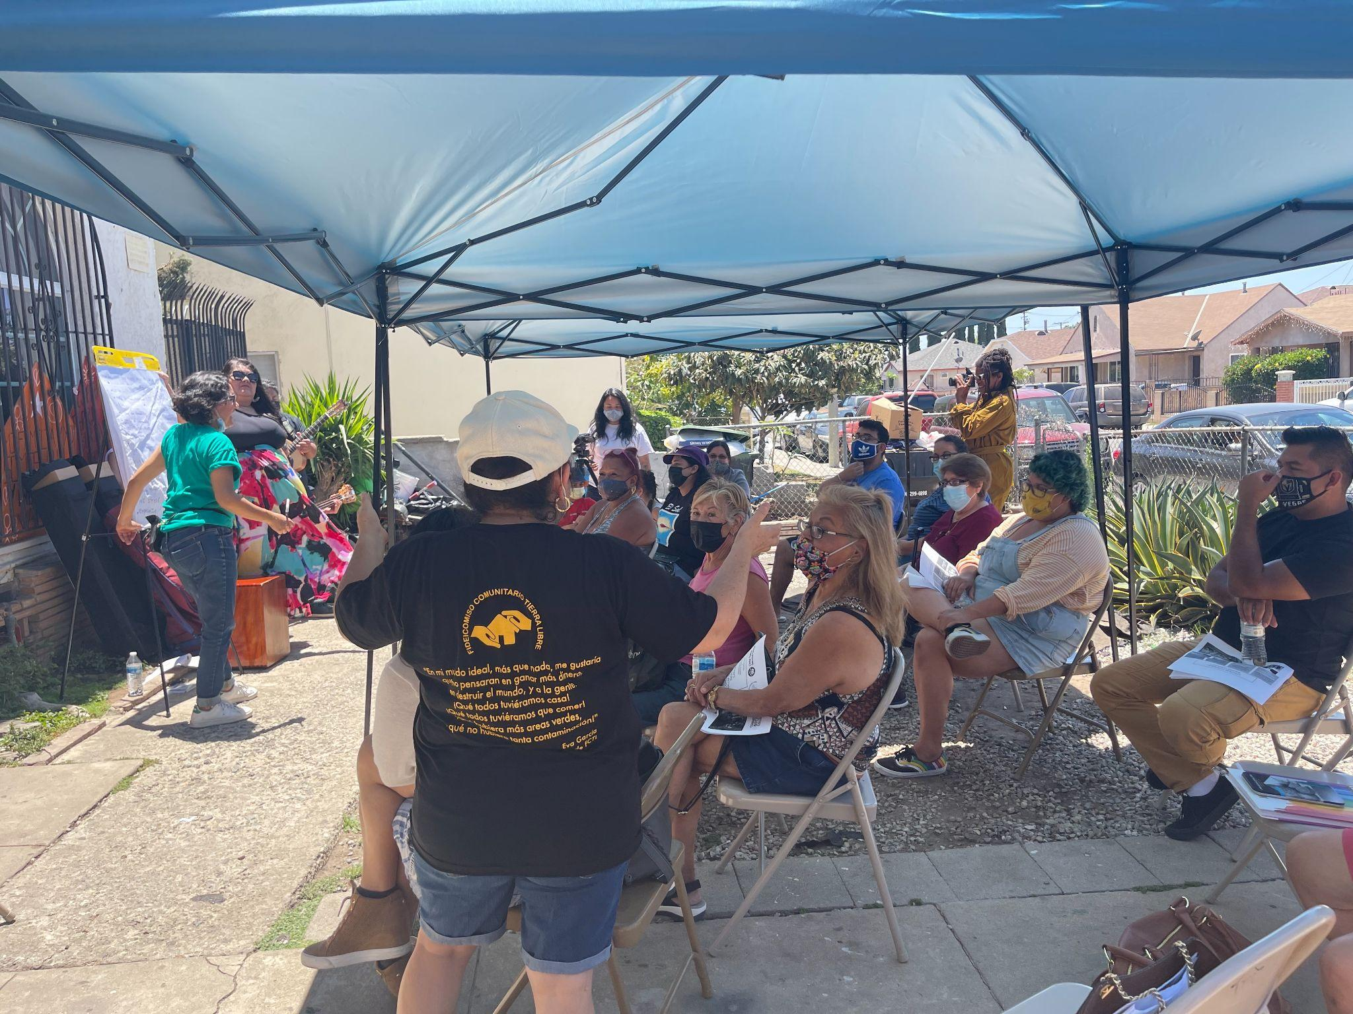
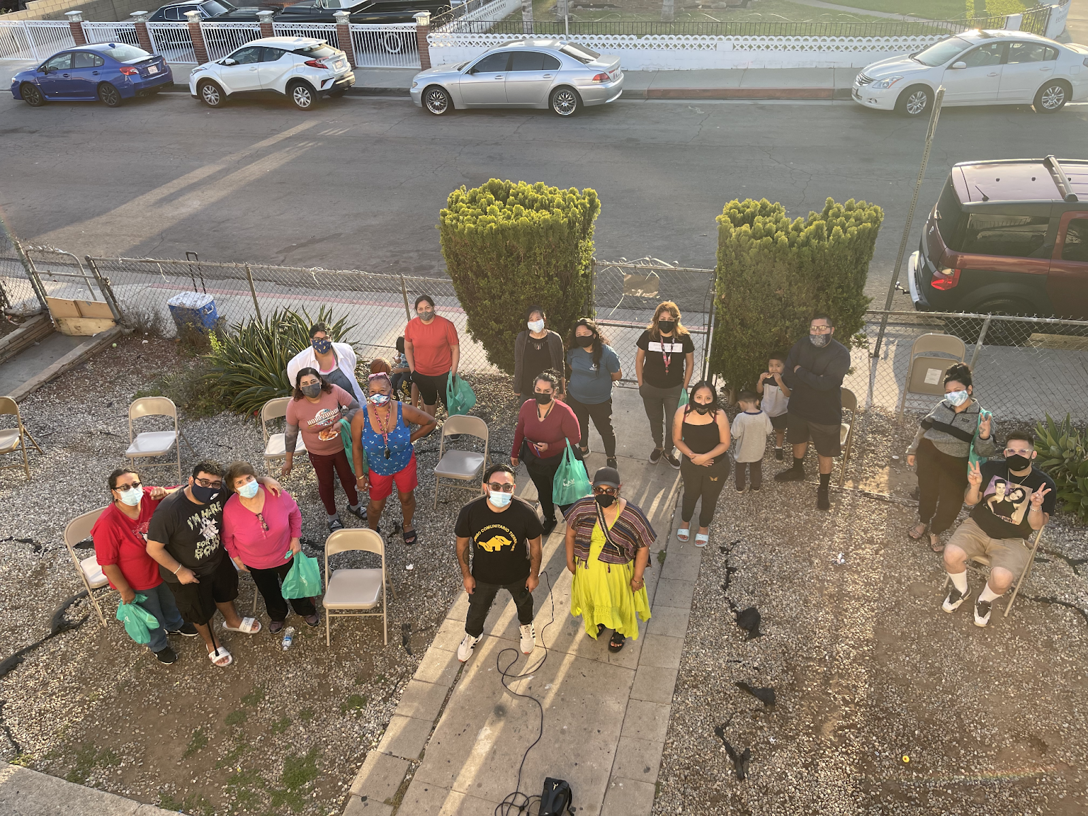
Case Study: Simmons Building
Jan -April 2021
LACLT Coalition advocates for CLT Pilot Program. 14 million dollars
Simmons Building is identified via research. Door knocking is coordinated with CPC/FCTL at the building providing direct services. At the same time LTSC/FCTL make an offer on the building.
May 2021
Building is Acquired. First Tenant Meeting. FCTL/LTSC/CPC formally introduce ourselves. Majority of the households attend.
June 2021
FCTL and CPC have cultural event where Quetzal the band and artist from Colombia facilitate a convivio. We follow up with a resource fair and block party. The intention is to build relationships with tenants and neighbors.

Slide 18
Estudio de caso: Edificio Simmons
Ene -Abril 2021
La Coalición LACLT aboga por el Programa Piloto CLT. 14 millones de dólares
Simmons Building se identifica a través de la investigación. El llamado a la puerta se coordina con CPC/FCTL en el edificio que brinda servicios directos. Al mismo tiempo, LTSC/FCTL hacen una oferta por el edificio.
mayo 2021
Se Adquiere Edificio. Primera reunión de inquilinos. FCTL/LTSC/CPC nos presentamos formalmente. Asiste la mayoría de los hogares.
junio 2021
FCTL y CPC tienen evento cultural donde Quetzal, la banda y el artista de Colombia facilitan un convivio. Seguimos con una feria de recursos y una fiesta en la calle. La intención es construir relaciones con los inquilinos y vecinos.

Slide 19
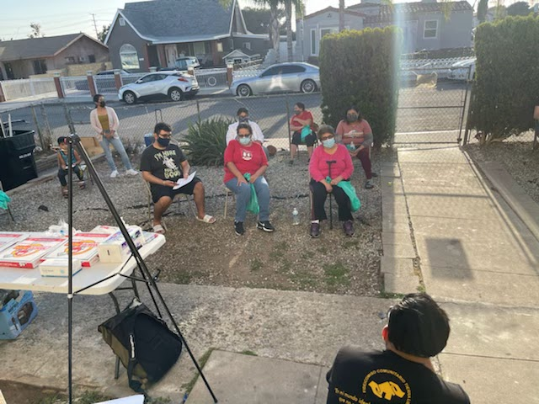
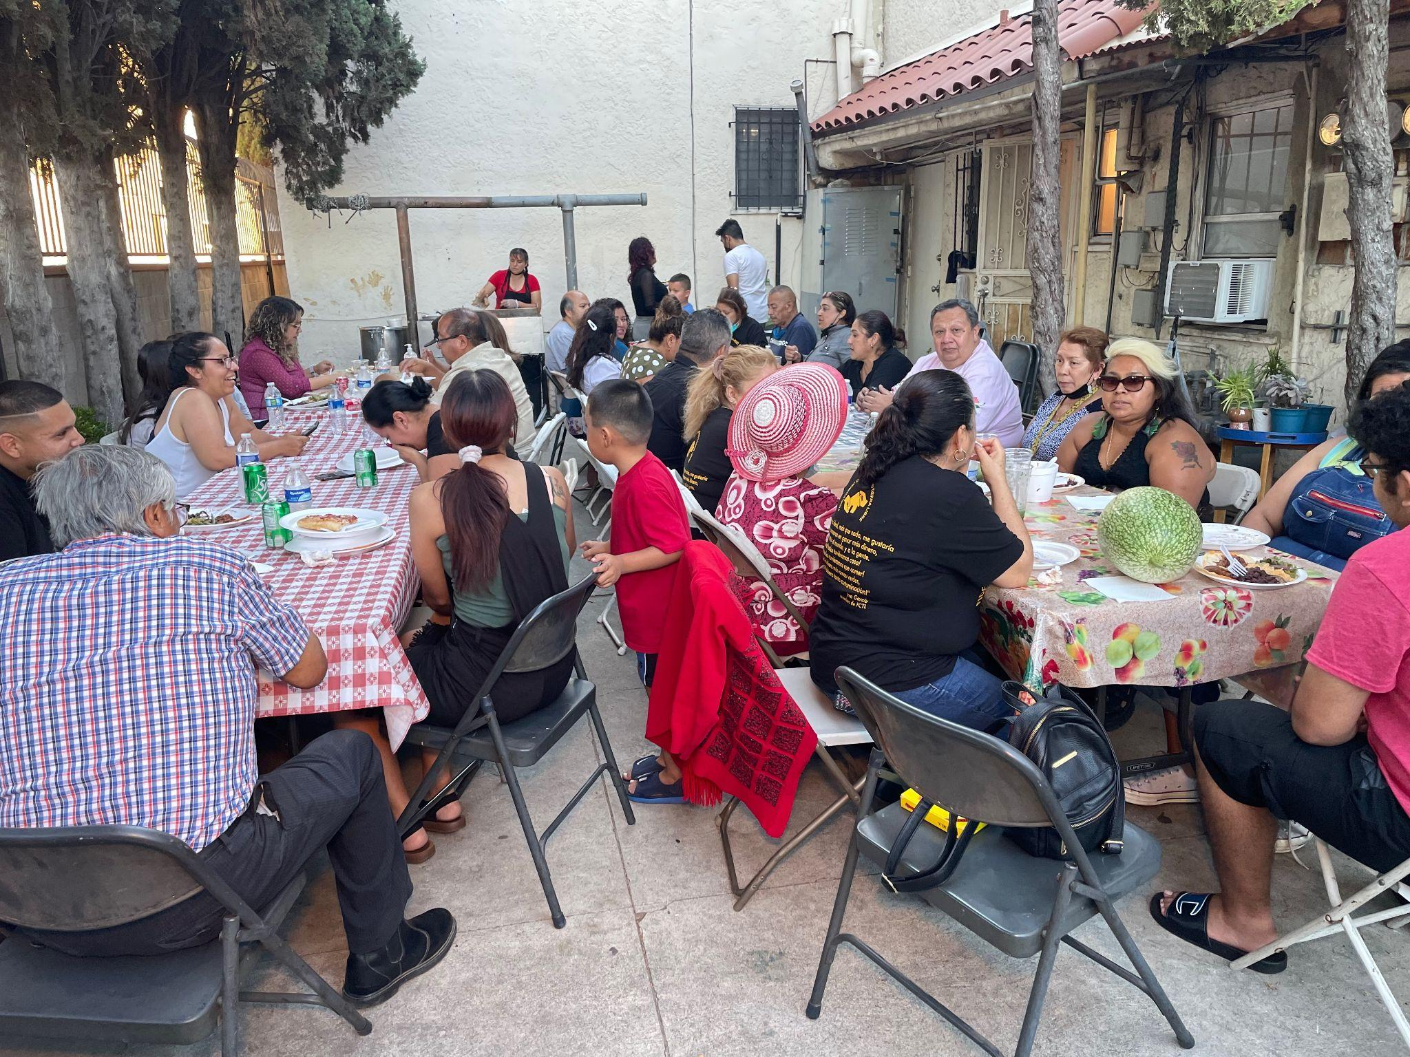
Case Study Continues
2022-2023
Monthly Meetings with LTSC, FCTL, and CPC staff and Tenants to: Build Relationships and Trust with Tenants.
Create space in the meetings for tenants to meet each other and get to know organizations. Learn about community land trust, tenant rights, and rehab of building.
Engage tenants with rehabilitation process and decision making. Since building was not fully organized prior to acquisition tenants and organizations are still addressing condition issues, trust building, and asserting tenant rights.
Jan 2023-July 2023
Tenant joins board of FCTL. Tenants are temporar relocated.
Engagement is focused on maintaining unity among tenants, continue meeting with tenants, and engage coop conversion.

Slide 20
Continúa el estudio de caso
2022-2023
Reuniones mensuales con el personal de LTSC, FCTL y CPC y los inquilinos para: Construir relaciones y confianza con los inquilinos.
Cree espacios en las reuniones para que los inquilinos se reúnan y conozcan organizaciones. Obtenga información sobre el fideicomiso de tierras comunitarias, los derechos de los inquilinos y la rehabilitación de edificios.
Involucrar a los inquilinos en el proceso de rehabilitación y la toma de decisiones. Dado que el edificio no estaba completamente organizado antes de la adquisición, los inquilinos y las organizaciones todavía están abordando los problemas de condiciones, la creación de confianza y la afirmación de los derechos de los inquilinos.
enero 2023-julio 2023
El inquilino se une a la junta de FCTL. Los inquilinos son reubicados temporalmente.
El compromiso se centra en mantener la unidad entre los inquilinos, seguir reuniéndose con los inquilinos y participar en la conversión cooperativa.

Slide 21
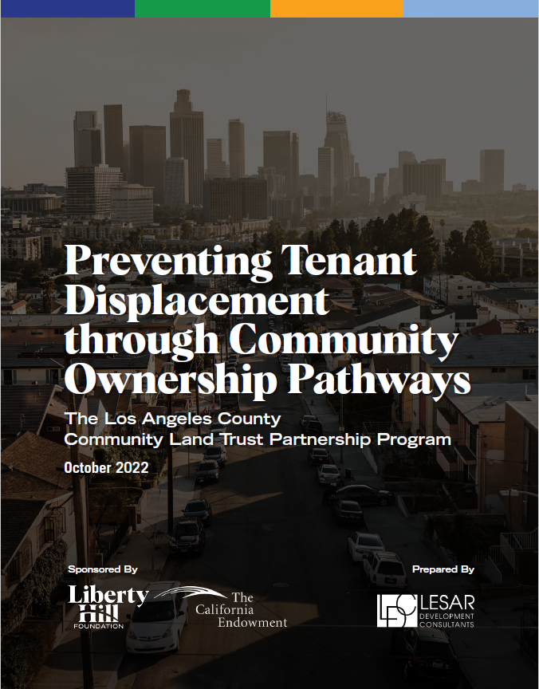
“Preventing Tenant Displacement through Community Ownership Pathways”
Key Takeaways from the Report:
Liberty Hill Foundation, with support from the California Endowment, commissioned this independent report to examine how the Los Angeles Community Land Trust Coalition and other partners came together to codesign and implement this $14 million acquisition and rehabilitation program with the County of Los Angeles.

Slide 22
Q&A
Roberto Garcia-Ceballos, Co-Director (FCTL)

Slide 23
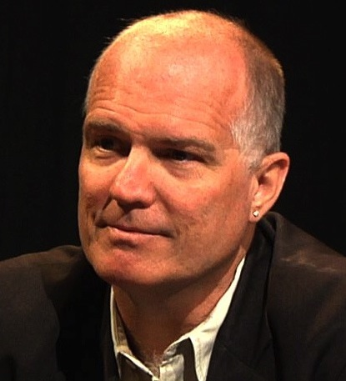
Intro Speaker:
David Cobb
David Cobb, Advancement Manager, Dishgamu Humboldt CLT

Slide 29
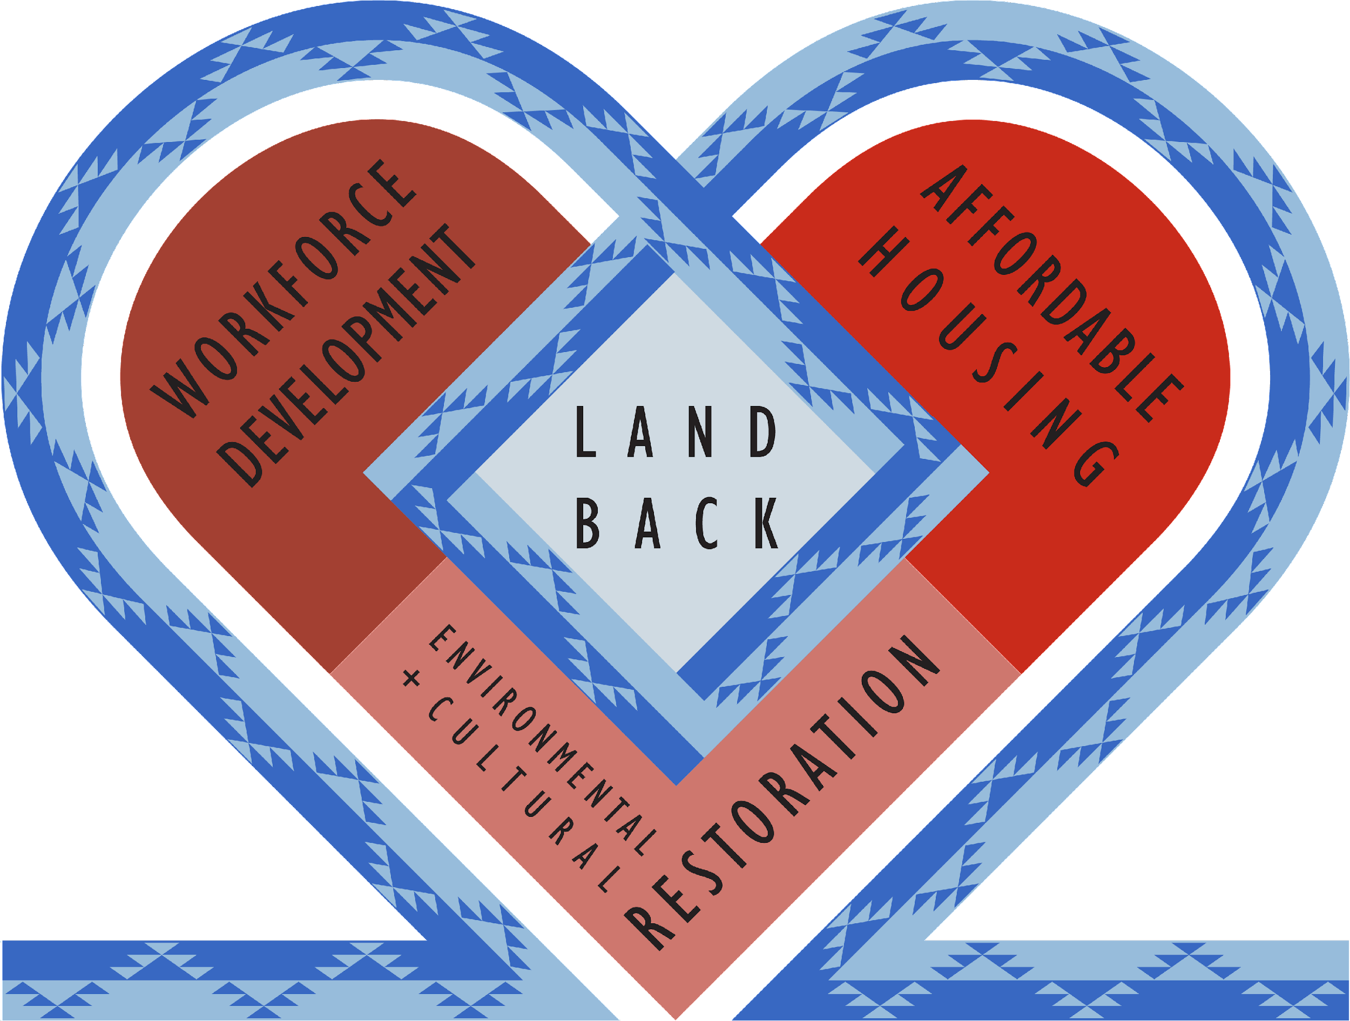

Slide 31
LALILH RR AWAYU
four rivers
’GHURR CURRENT PROJECTS
GREEN CONSTRUCTION
We have developed a detailed feasibility study for the construction of mid-rise, mixed-use multifamily housing using MASS TIMBER - an innovative building material that sequesters carbon, reduces project costs, and supports sustainable forestry.
We are currently working with local government partners to develop UNDERUTILIZED URBAN SITES that would allow us to introduce this technology to our region, creating a market for local green construction jobs.

Slide 32
Q & A:
David Cobb
David Cobb, Advancement Manager, Dishgamu Humboldt CLT

Slide 33
Breakout Groups
Where does the presenters’ material speak to your current work or vision?
What partnerships do you have in place, or could you build, for this work?
Share Outs

Slide 34
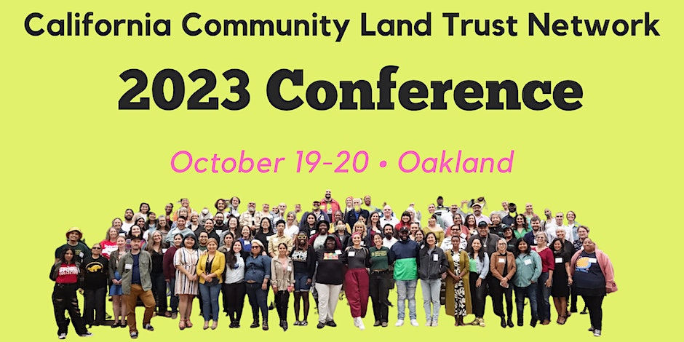
Coming Up…
Register here
Notes:
https://www.eventbrite.com/e/2023-clt-network-conference-sjv-tickets-694776082967?

Slide 35
New Opportunities
CLT Conference agenda includes:
CACLTN Legislative updates
Community Ownership in the Central Valley
Intersections: Indigenous community ownership efforts, CLTs and Land Conservation
Tenant organizing & Anti-displacement efforts
Real Estate Acquisitions
Tenancy in Common for CLTs
Bus tour of East Bay CLTs
Evening Reception & more…

Slide 36
Polls
Would you like to continue receiving CLT network trainings?
Receive TA assistance?
Interested in attending the 2023 conference?

Slide 37
Funding Updates
Sources:
FIHPP: Foreclosure Intervention Housing Preservation Program; funds begin 2024
COCP: Community Ownership for Community Power Fund, funds begin 2024
CERF: Learning Series, State Funding Ops
DOE’s program: Renew America’s Nonprofits
CSGC’s Transformative Climate Communities (TCC)

Slide 38
Announcements
Slides & PDF resources will be shared via email and online (CACLTN resource page)
CLT Network membership
TA resources: Real Estate, Business Planning, Legal
Convening opportunities
Published guides & research
Other resources

Slide 39
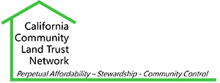
Thank you for joining us!
Special thanks to our speakers, the SJV Funders’ Collaborative and Smart Growth CA

